Slide 1
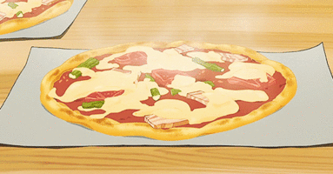
Late-night Pizza
Sample synchronization problem

Slide 2
Late-Night Pizza
A group of students study for exams
Can only study while eating pizza
Each student thread executes the following:
while (true) {
pick_up_a_piece_of_pizza;
study_while_eating_the_pizza;
}
If a student finds pizza is gone, the student goes to sleep until another pizza arrives
First student to discover pizza is gone orders a new one
Each pizza has S slices.
Notes:
Adapted from http://www.cs.duke.edu/~chase/cps110-archive/prob1-00s.pdf

Slide 3
Late-Night Pizza
Synchronize student threads and pizza delivery thread
Avoid deadlock
When out of pizza, order it exactly once
No piece of pizza may be consumed by more than one student.

Slide 4
Semaphore solution
shared data:
semaphore pizza; (counting semaphore, init to 0, represent number of available pizza resources)
semaphore deliver; (binary, init to 1)
int num_slices = 0;
semaphore mutex; (init to 1) // related to num_slices
Student {
diligent=true;
while (diligent) {
P(pizza);
P(mutex);
num_slices--;
if (num_slices==0)
// took last slice
V(deliver);
V(mutex);
study();
}
}
DeliveryGuy {
employed=true;
while(employed) {
P(deliver);
make_pizza();
P(mutex);
num_slices=S;
V(mutex);
for (int i=0,i<S,i++) {
V(pizza);
}
}
}

